Slide 1

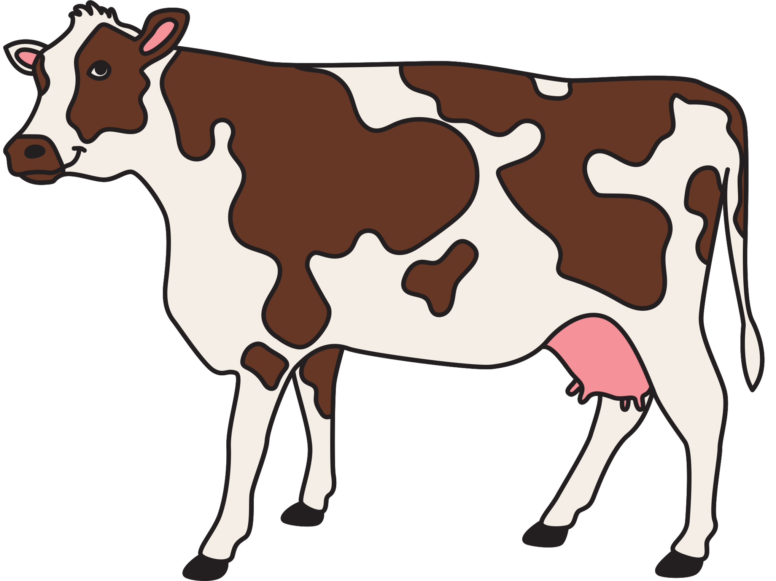


Cattle Disease Detection Project

Slide 2
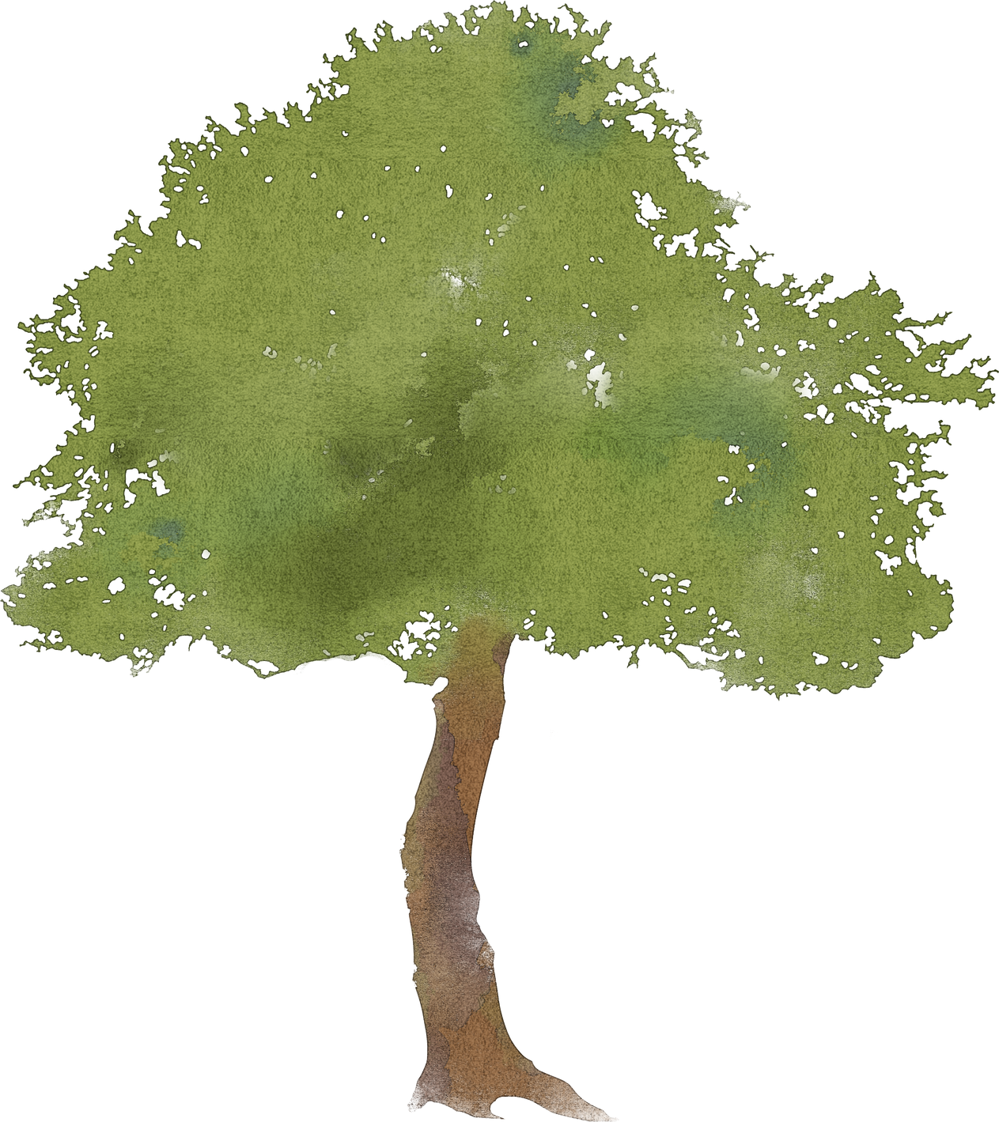

INTRODUCTION
Context: Importance of livestock health and early disease detection.
Challenge: Difficulty in diagnosing cattle diseases with traditional methods.
Solution: AI-powered disease detection tool based on symptoms.

Slide 3

PROBLEM STATEMENT
The cattle farming industry faces significant challenges due to the lack of early disease detection systems. Diseases in cattle can cause severe financial losses, reduced productivity, and even the spread of infections.
Problem: Farmers often struggle to diagnose diseases in cattle on time, especially in rural areas with limited access to veterinary services.
Impact: Delayed diagnosis leads to increased mortality rates, reduced milk production, and higher medical costs.

Slide 4


OBJECTIVES
Early and accurate disease detection
Integrating machine learning algorithms for better diagnoses.
Provide a simple and effective tool for farmers and veterinarians.

Slide 5

PROPOSED METHODOLOGY
Our methodology involves collecting data on symptoms and diseases, preprocessing the data, and implementing multiple machine learning models to predict diseases in cattle.
Data Collection: Gather data on symptoms and diseases in cattle from veterinary and agricultural databases.
Data Preprocessing: Clean and format the dataset to remove inconsistencies and ensure it's ready for machine learning training.
Model Development: Implement and train the following algorithms:
K-Nearest Neighbors Decision Tree
Random Forest Logistic Regression
Naive Bayes K-Nearest Neighbors
Model Evaluation: Evaluate the models using accuracy, precision, recall, and F1 score metrics.
User Interface: Develop a desktop interface where users input symptoms and receive prediction

Slide 6

SYSTEM FEATURES
Symptom Input: Simple interface to input symptoms observed in cattle.
AI Diagnosis: AI models (Decision Tree, Random Forest, KNN, etc.) analyze symptoms to provide disease predictions.
Learning Over Time: Continuous improvement of AI models for better accuracy.

Slide 7
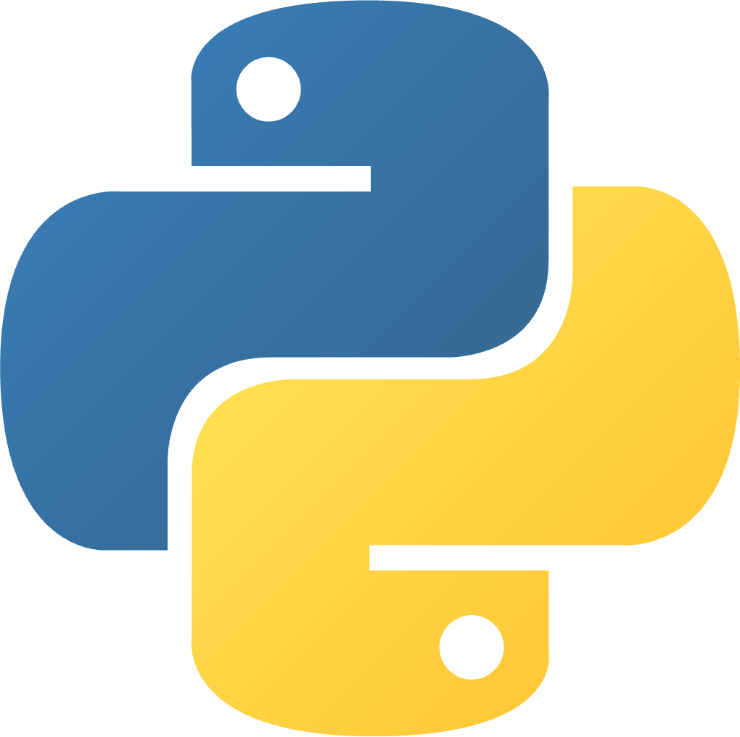
TECHNOLOGY STACK
Frontend: Tkinter (Python)
AI Algorithms: Decision Tree, Random Forest, Naive Bayes, KNN, Logistic Regression
Backend: Python (Machine Learning Integration)
Database: Storing symptoms and results for improved prediction accuracy (using SQL)

Slide 8

PROJECT PHASES
Data Collection
Algorithm Training
System Development & Integration
Testing & Validation
Deployment

Slide 9
RESULTS
The expected results include:
Prediction Accuracy: An effective machine learning model capable of accurately predicting diseases based on symptoms.
User Feedback: A simple and interactive interface for farmers to input symptoms and receive diagnosis results.
Model Comparison: Evaluation of different models to determine which one provides the highest accuracy and reliability in disease detection.

Slide 10
RELATED WORK
Several attempts have been made to use machine learning for disease prediction in animals, but these methods are not widely accessible or tailored to cattle farming needs.
Study 1: A similar system for poultry disease prediction using decision trees and random forests showed promising results, but it was not adapted for cattle.
Study 2: An application for livestock disease management focused on general veterinary care but lacked machine learning capabilities for specific disease prediction.
Gaps: No comprehensive solution exists that combines machine learning models with a user-friendly interface specifically for cattle disease detection.

Slide 11

CONCLUSION
Key Takeaways:
Early detection of cattle diseases can prevent economic losses and ensure better health management for livestock.
Machine learning provides a powerful tool to predict diseases based on symptoms, making it accessible even in remote areas.
Impact: The project can greatly benefit farmers by helping them manage cattle health more efficiently, improving productivity and preventing disease outbreaks.
Future Work:
Expand the dataset with more diseases and symptoms for better model accuracy.
Develop a mobile version for wider accessibility.
Implement real-time monitoring features using IoT for continuous disease detection.

Slide 12

THE TEAM
Ahmed Hassan Mahfouz
Ahmed Mustafa Alazab
Aboelftouh abdelsamad Aboelftouh
Ebrahem Mahmoud AbdelGawad
Mohamed Eldesoky Fadl

